Slide 1
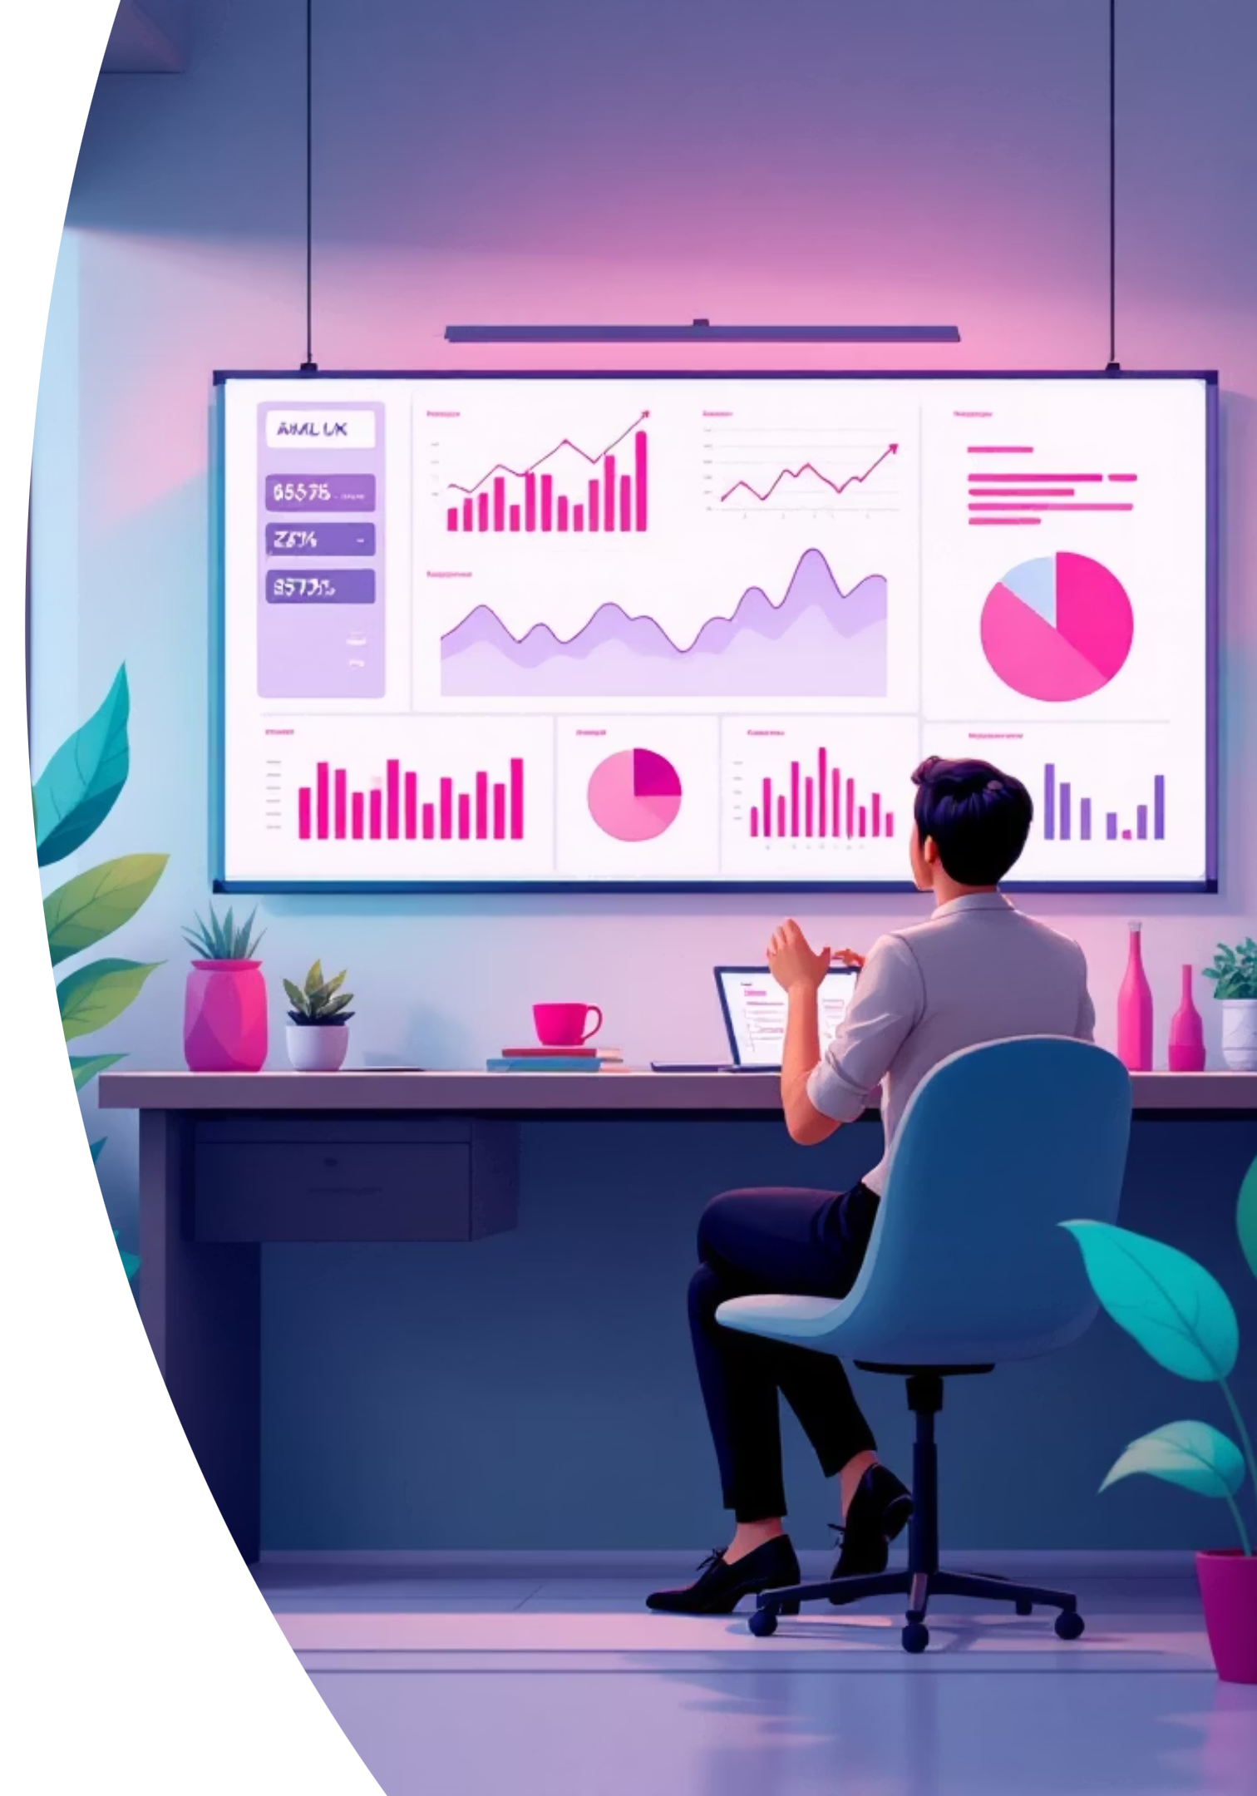
Customer Shopping Behavior Analysis
Uncovering insights from 3,900 purchases to drive strategic decisions

Slide 2

OVERVIEW
Project Scope
Our Mission
Analyze transactional data to uncover spending patterns, customer segments, and product preferences
3.9K
18
4
Purchases
Data Points
Categories

Slide 3



DATA FOUNDATION
Dataset at a Glance
Demographics
Purchase Details
Behavior Metrics
Age, gender, location, subscription status
Item, category, amount, season, size, color
Discounts, reviews, frequency, shipping preferences

Slide 4

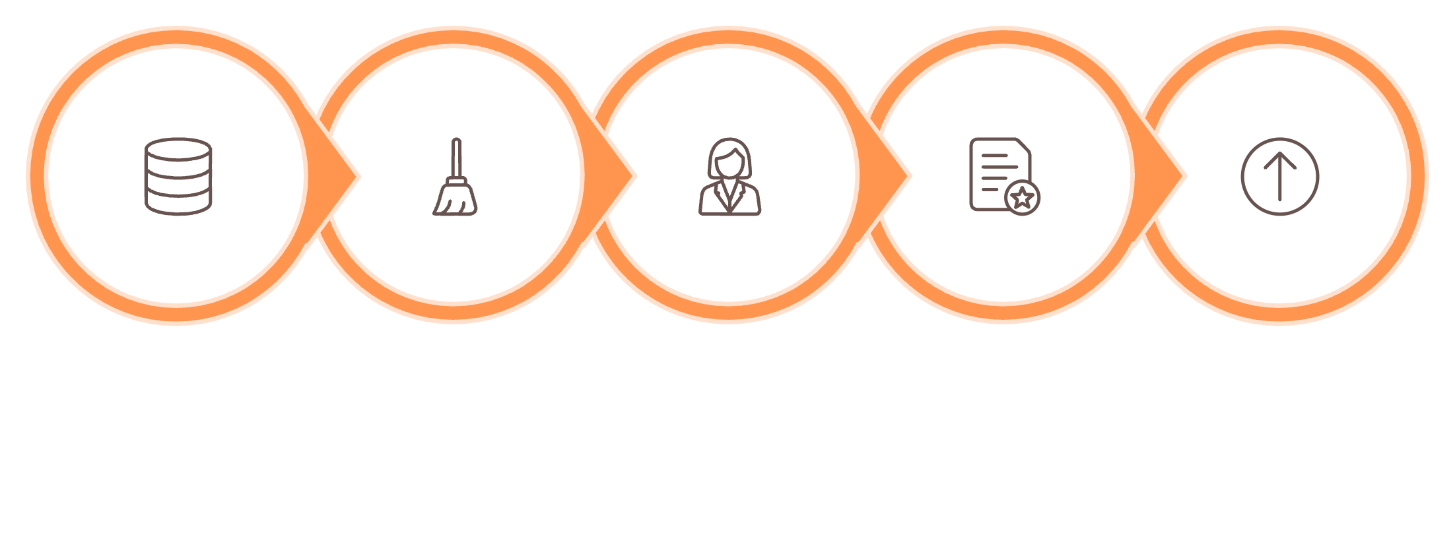
PYTHON
Data Preparation Process
Cleaning
Imputed 37 missing review ratings using category medians
Engineering
Created age groups and purchase frequency metrics
Clean & Standardize
Handle Missing Values
Engineer Features
Export to Database
Load Data
Integration
Systematic approach ensuring data quality and consistency
Connected to PostgreSQL for advanced analysis

Slide 5
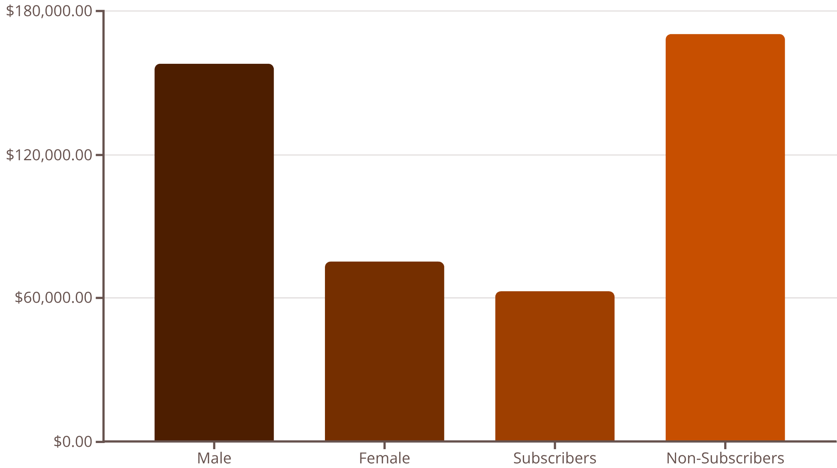
SQL ANALYSIS
Revenue Insights
Key Findings
Gender Gap
Male customers generate 2.1x more revenue than female customers
Subscription Paradox
Non-subscribers drive 73% of total revenue despite lower engagement

Slide 6
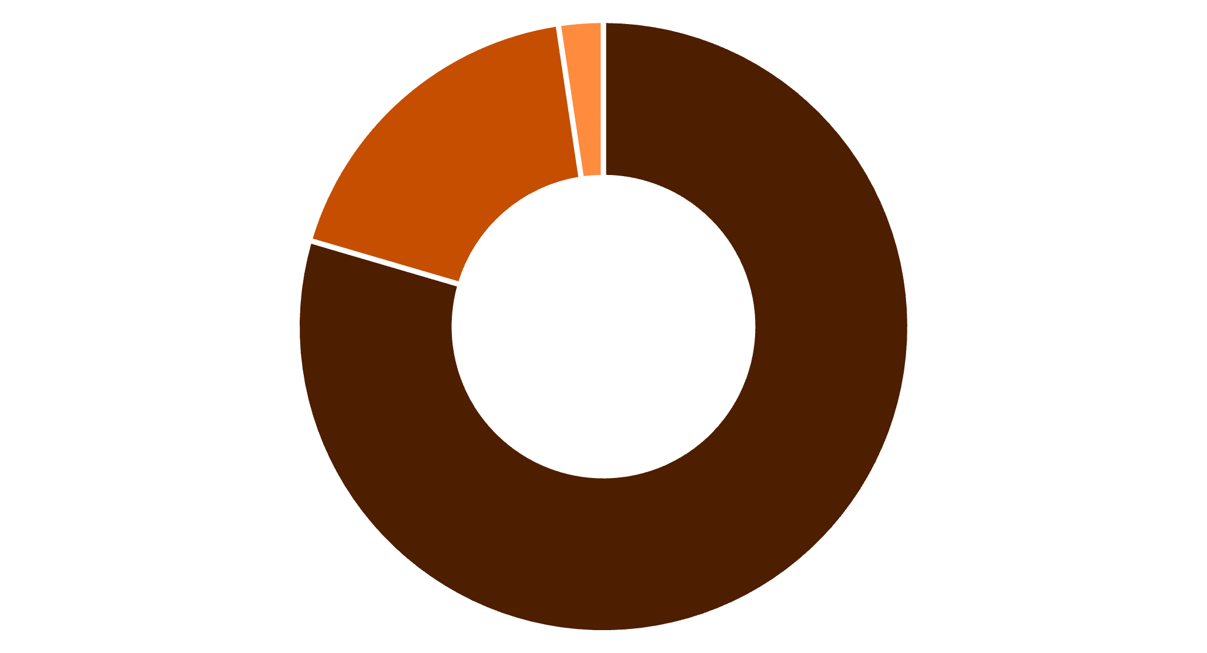
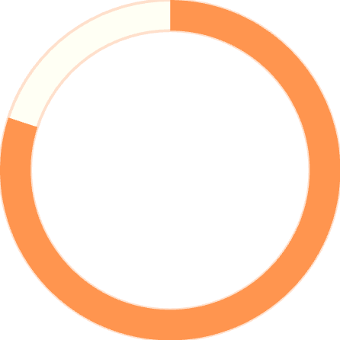
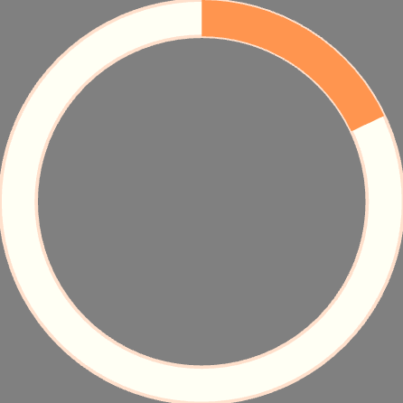
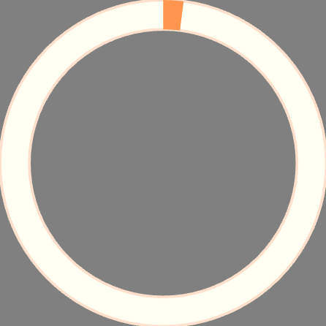
Customer Segmentation
Loyal
Returning
New
Loyalty Landscape
80% of customers are classified as loyal, presenting opportunities for retention programs
80%
18%
2%
Loyal Customers
Returning
New

Slide 7




Product Performance
Gloves
Sandals
Boots
Hat
Highest rated at 3.86 stars
Strong performance at 3.84 stars
Customer favorite at 3.82 stars
Top seller at 3.80 stars

Slide 8
DISCOUNT ANALYSIS
Smart Spenders
839 Customers
Used discounts but still spent above average
50%
49%
Hat Discount Rate
Sneakers
Discount-Dependent Products
50%
49%
49%
Hat
Sneakers
Coat
48%
47%
Sweater
Pants

Slide 9

POWER BI
Interactive Dashboard
Category Leaders
Age Distribution
Subscription Split
Clothing dominates with $100K revenue, 2K sales
Young adults lead with $62K revenue contribution
27% subscribers vs 73% non-subscribers

Slide 10




RECOMMENDATIONS
Strategic Actions
Boost Subscriptions
Promote exclusive benefits to convert non-subscribers
Loyalty Programs
Reward repeat buyers to strengthen engagement
Targeted Marketing
Focus on high-revenue age groups and express shipping users

